Slide 1
COST
Statistical Estimation Theory
Hypothesis Testing

Slide 2
Statistical Hypothesis

Slide 3
Hypothesis
Hypothesis is a claim or idea about a group or population.
Hypothesis refers to an educated guess or assumption that can be tested.
Hypothesis is formulated based on previous studies.

Slide 4

Types of Hypothesis
1. Null Hypothesis (𝐻o)-
A statistical hypothesis which is formulated for the purpose of rejecting or nullifying it.
2. Alternate Hypothesis (𝐻1)-
Any hypothesis which differs from the given null hypothesis.
The alternative hypothesis is what you might believe to be true or hope to prove true.

Slide 5
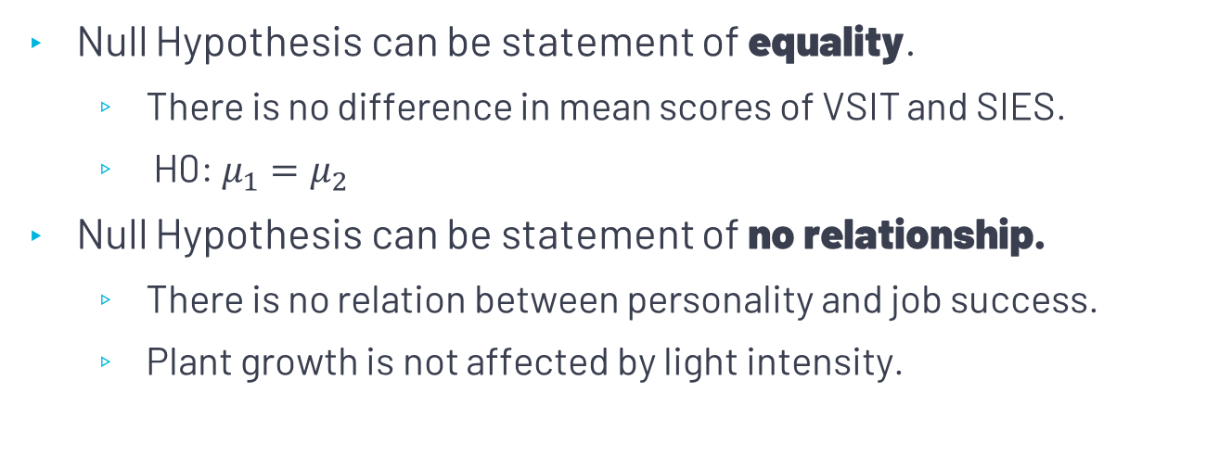
Null Hypothesis
Null Hypothesis can be statement of equality.
There is no difference in mean scores of VSIT and SIES.
H0: $μ_{1}=μ_{2}$
Null Hypothesis can be statement of no relationship.
There is no relation between personality and job success.
Plant growth is not affected by light intensity.

Slide 6
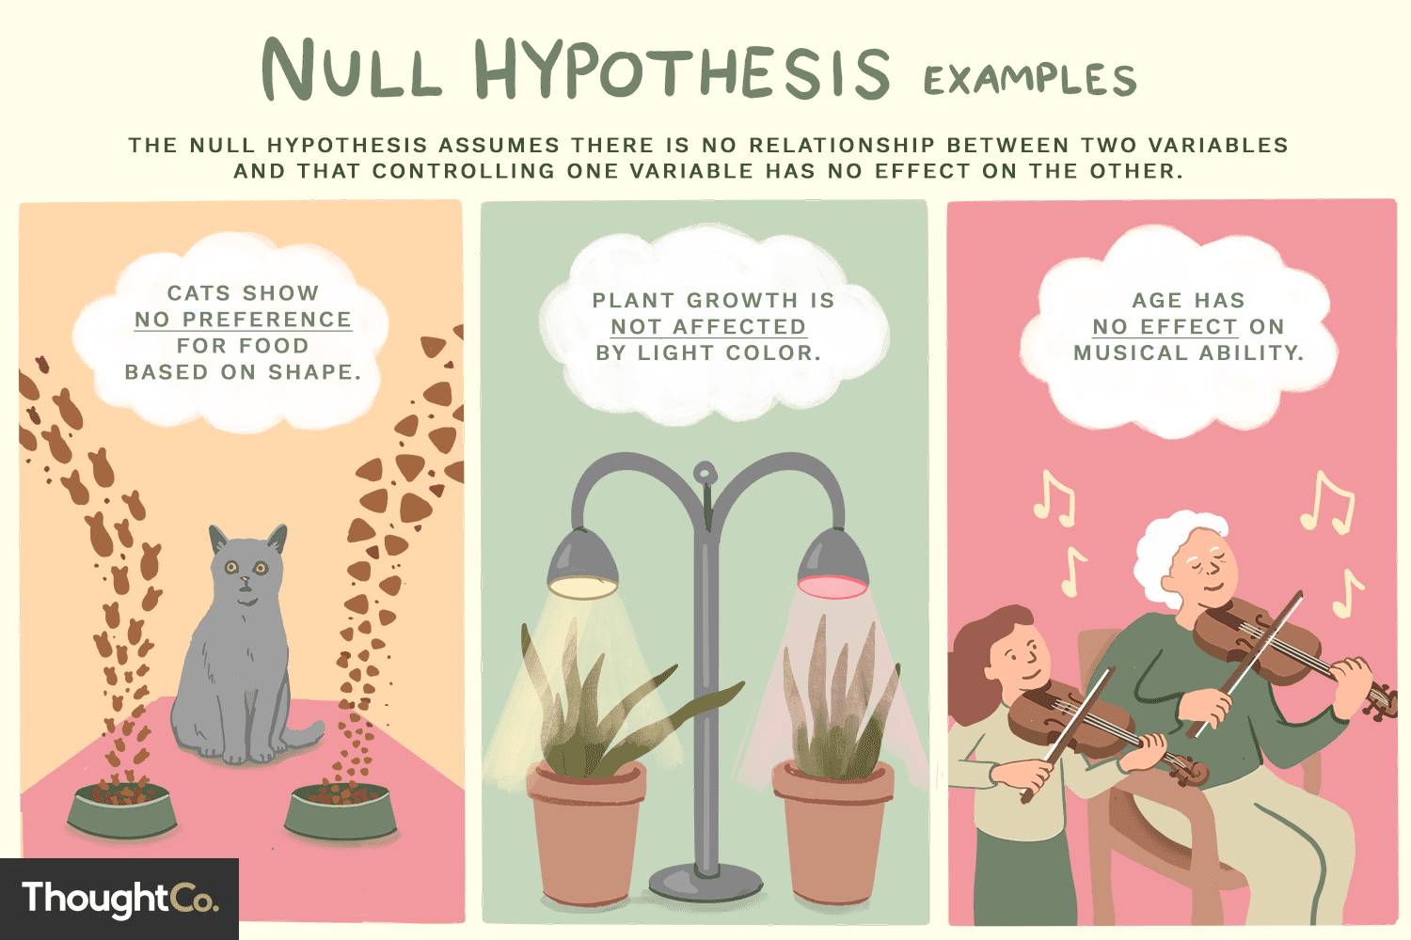

Slide 7
Hypothesis Testing
Two tailed and One Tailed Test

Slide 8
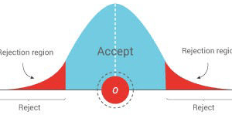
Hypothesis Testing
Decision-making process for evaluating claims about a population.
Whether to accept or reject Ho

Slide 9
Type I and Type II Errors
Type I Error
When we reject a hypothesis when it should be accepted
Type II Error
When we accept a hypothesis when it should be rejected

Slide 10
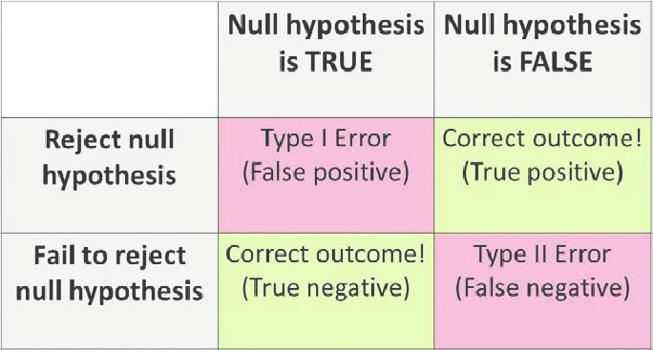

Slide 11
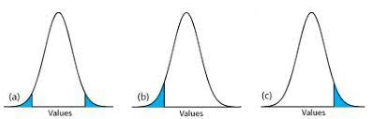
Two Tailed and One Tailed Test
Two Tail Test: critical area of a distribution is two-sided and tests whether a sample is greater than or less than a certain range of values.
If the sample being tested falls into either of the critical areas, the alternative hypothesis is accepted instead of the null hypothesis.

Slide 12
Two Tailed and One Tailed Test
One tail test: A one-tailed test is a statistical test in which the critical area of a distribution is one-sided so that it is either greater than or less than a certain value, but not both.
If the sample being tested falls into the one-sided critical area, the alternative hypothesis will be accepted
instead of the null hypothesis.

Slide 13
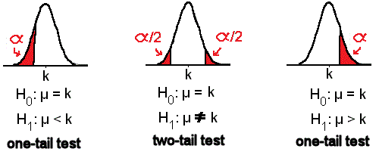
Two Tailed and One Tailed Test

Slide 14
Two Tailed and One Tailed Test
One-tailed tests are applied to answer for the questions: Is our finding significantly greater than our assumed value? Or: Is our finding significantly less than our assumed value?
Two-tailed tests are applied to answer for the questions: Are the findings different from the assumed mean?

Slide 15
Level of Significance
Maximum allowable probability of making type I error.
This probability is denoted by 𝛼
A significance level of 0.05 (5%) 𝑜𝑟 0.01 (1%) is common.

Slide 16
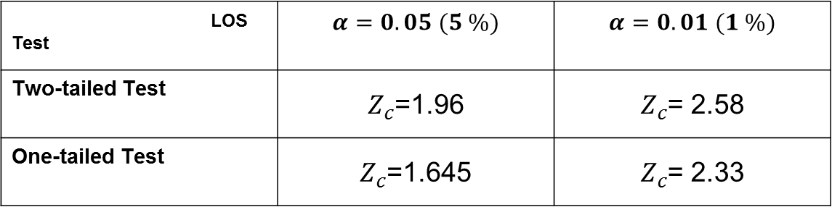

Critical Value $Z_{c}$
LOS Test | $$α=0.05 (5 \%)$$ | $$α=0.01 (1 \%)$$
Two-tailed Test | $Z_{c}$=1.96 | $Z_{c}$= 2.58
One-tailed Test | $Z_{c}$=1.645 | $Z_{c}$= 2.33

Slide 17

Z Score
Mean
$$Z=\frac{\overline{X}−μ}{\frac{σ}{\sqrt{N}}}$$
Proportion
$$Z=\frac{P −p}{\sqrt{\frac{pq}{N}}}$$

Slide 18

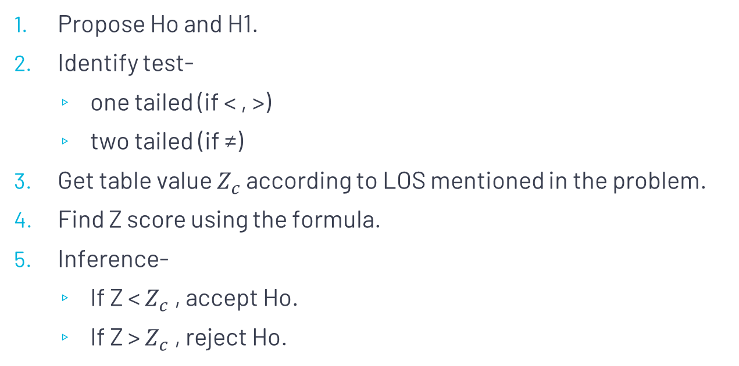

Steps for hypothesis testing
Propose Ho and H1.
Identify test-
one tailed (if < , >)
two tailed (if ≠)
Get table value $Z_{c}$ according to LOS mentioned in the problem.
Find Z score using the formula.
Inference-
If Z < $Z_{c}$ , accept Ho.
If Z > $Z_{c}$ , reject Ho.
Reject Ho
Accept Ho
Reject Ho
$$Z_{c}$$
$$Z_{c}$$

Slide 19
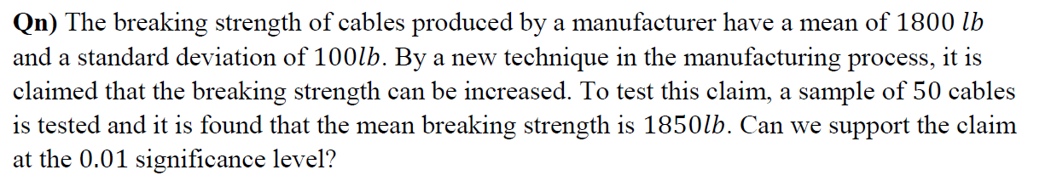
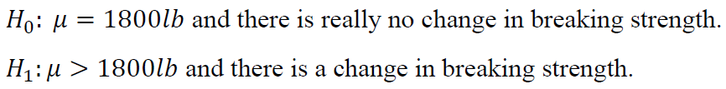
Question
Step 1- Propose H0
Step 2- Identify Test
As > sign is there, use One tailed Test

Slide 20
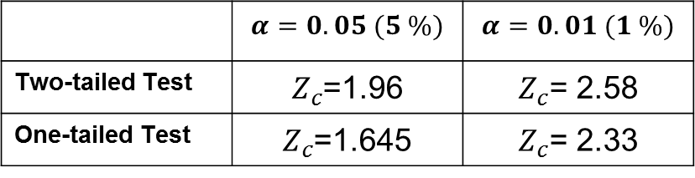
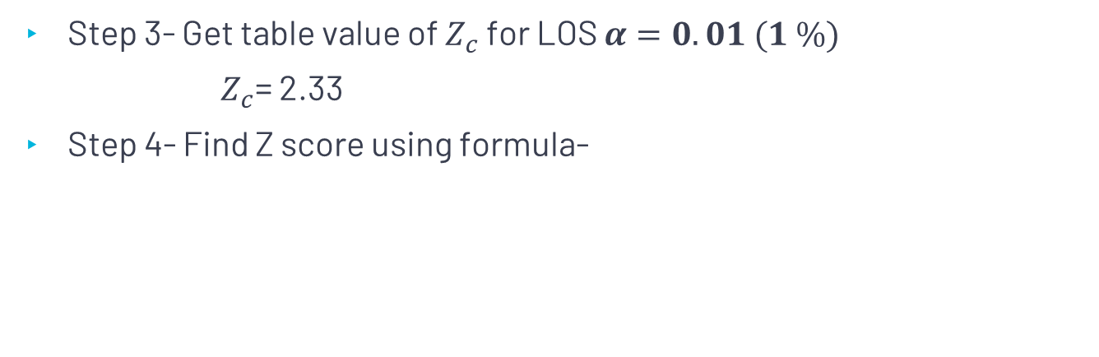

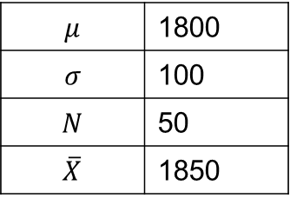

Cont.…
 | $$α=0.05 (5 \%)$$ | $$α=0.01 (1 \%)$$
Two-tailed Test | $Z_{c}$=1.96 | $Z_{c}$= 2.58
One-tailed Test | $Z_{c}$=1.645 | $Z_{c}$= 2.33
Step 3- Get table value of $Z_{c}$ for LOS $α=0.01 (1 \%)$
$Z_{c}$= 2.33
Step 4- Find Z score using formula-
$$μ$$ | 1800
$$σ$$ | 100
$$N$$ | 50
$$\overline{X}$$ | 1850
$$Z=\frac{\overline{X}−μ}{\frac{σ}{\sqrt{N}}}$$
$Z=$3.5355

Slide 21
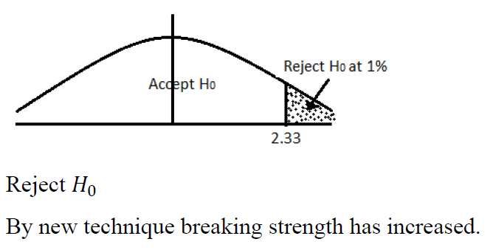

Cont. ..
Step 5 – Inference
$\text{Z}\text{ > }Z_{c}$, reject Ho.

